Slide 1


Detect a Network Scan
Curtis Crawford

Slide 2
What it looks like
Wireshark pcap
01
What it tells us
02
conclusion
03

Slide 3
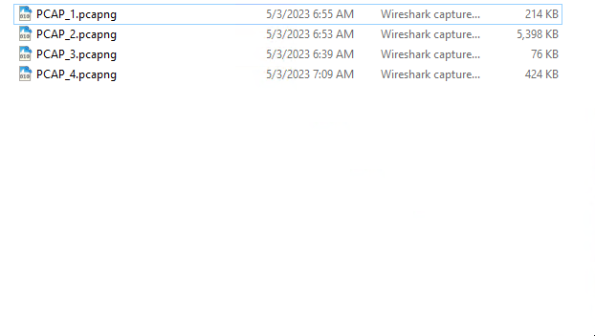
Wireshark PCAP
Today we’re going to be viewing a Wireshark PCAP. This is a series of Packets (P) that were captured (CAP) and saved for viewing at a later time. These types of logs can come in very handy for reviewing a network and it’s activity.

Slide 4
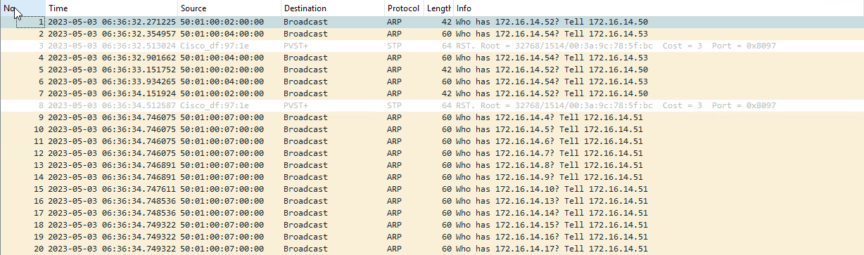
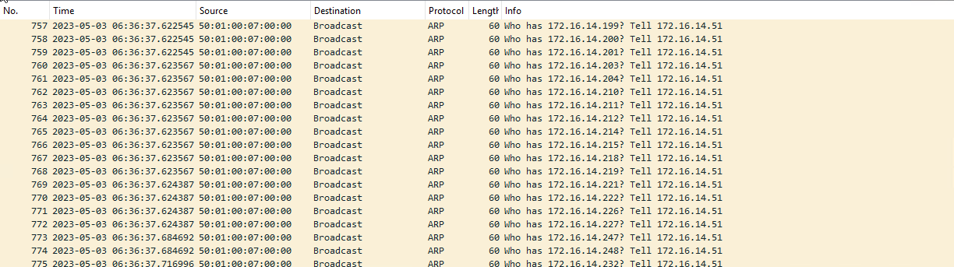
Wireshark PCAP of a Network Scan
Here we can see that we’re getting multiple lines of ARP requests, that all have the same destination. This is what happens when a Network Scan is being done. The “attacker” sends multiple queries and looks for replies that will tell them what hosts are online.

Slide 5

Conclusion
Wireshark is an incredibly important tool that you’ll find yourself using on a regular basis when working in the field of Cyber Security. Network scans are just one of the countless threats that Wireshark can help to identify. “Wireshark is a free and open-source packet analyzer. It is used for network troubleshooting, analysis, software and communications protocol development, and education.” –Wikipedia

